Slide 1



TEXT
EUR-USD
Bid Open Forecasting
Business Data Forecasting

Slide 2
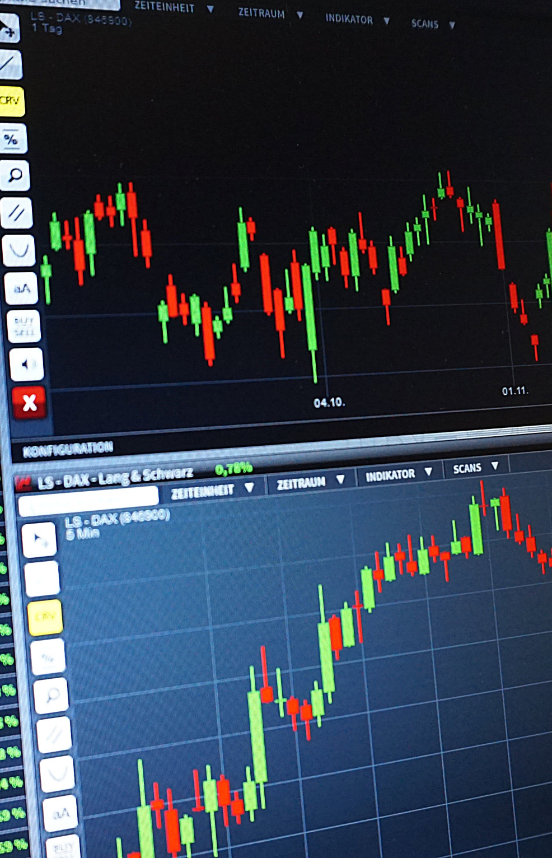
About The Data
We are trying to predict the forex rates forthe currency pair of EUR or USD
Present with ease and wow any audience with Canva Presentations. Choose from over a thousand professionally-made templates to fit any objective or topic. Make it your own by customizing it with text and photos.

Slide 3



We are a firm looking to sell dollars to Bob, when is the best day to sell to Bob at the best price?
We aim to analyse historical BID Open rates collected on an hourly basis to be able to predict the bid open rates a few weeks into the future to be able to sell at the best rates

Slide 4
Models used for forecast
1
Moving Average
2
Auto Regression
Choose from over a thousand professionally-made templates to fit any objective or topic.
Choose from over a thousand professionally-made templates to fit any objective or topic.
3
ARIMA
4
Holt Winter
Make it your own by customizing it
with text and photos.
Apply page animations and transitions
to emphasize ideas and make them even more memorable.

Slide 5
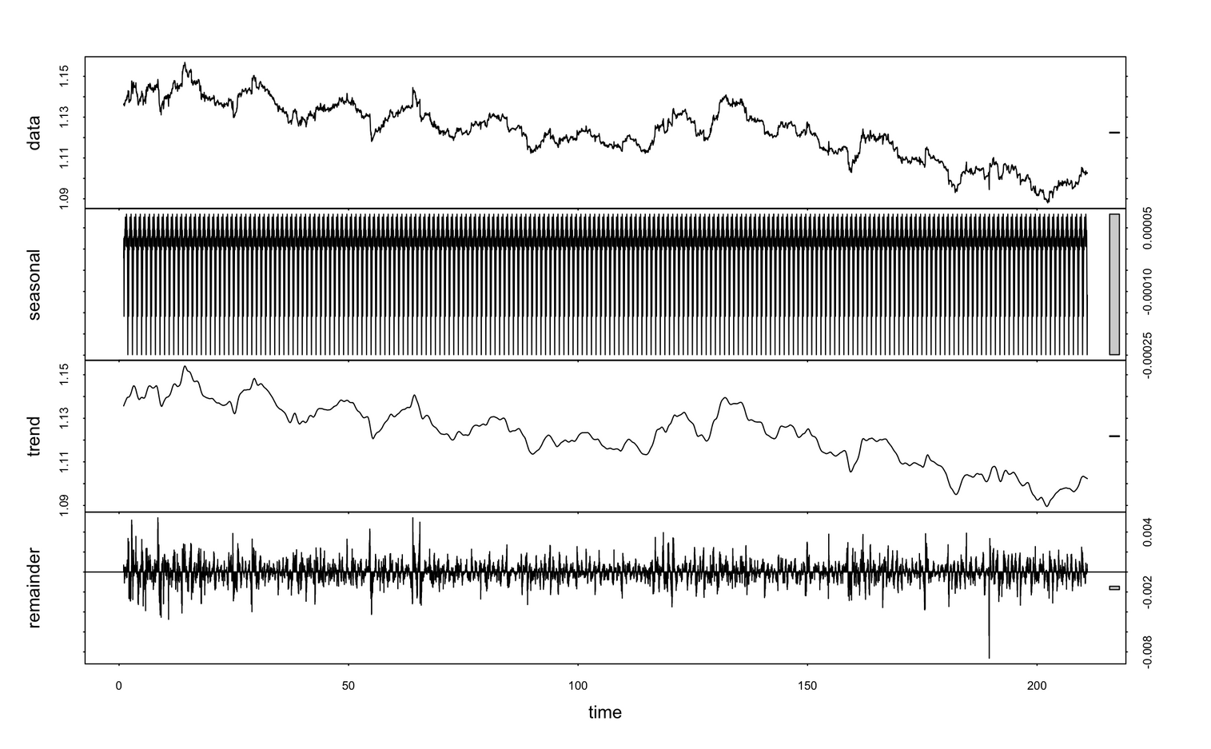

Data Decomposition
Observation
We Visualize a slight negative trend in the data for the past 30 weeks of forex rates. There is also a seasonality on a daily basis.

Slide 6
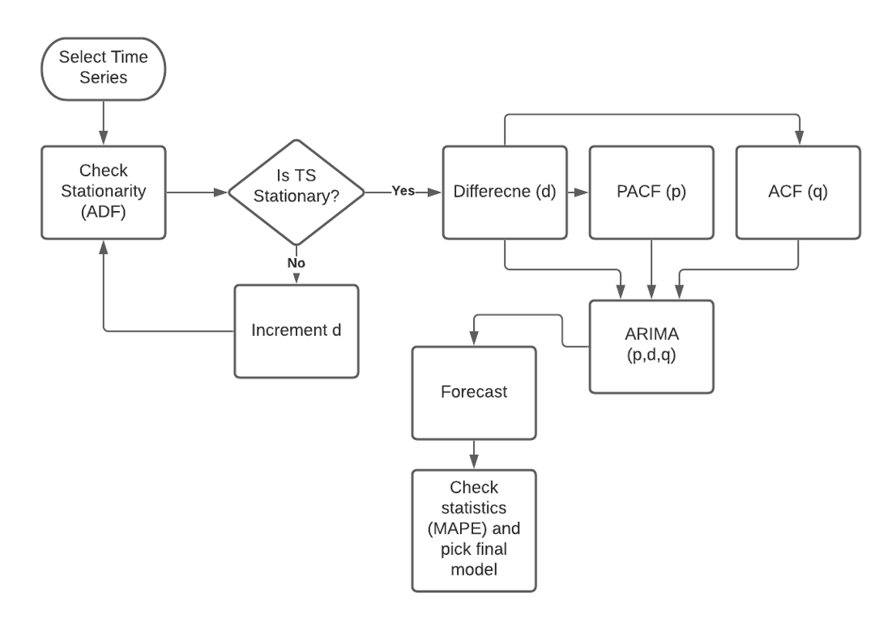
ARIMA Model
Process Steps
Sample text Sample text Sample text

Slide 7
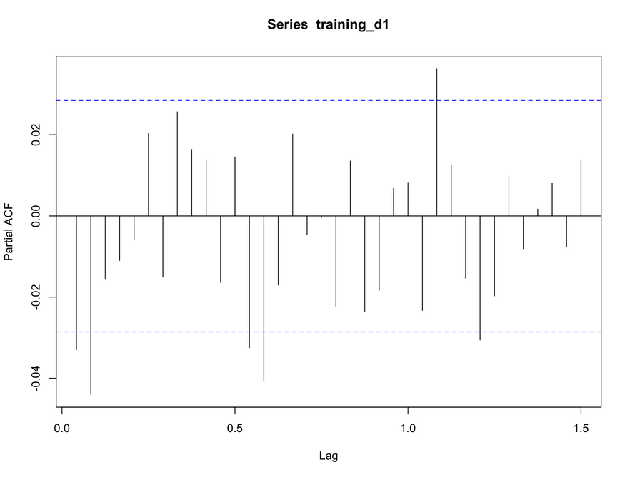
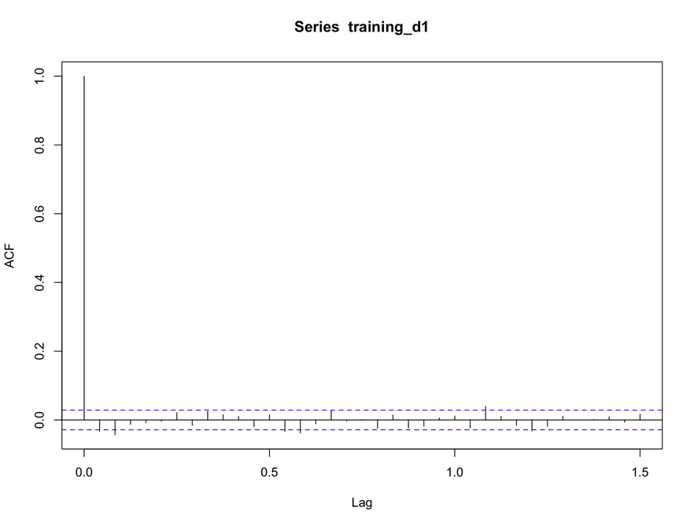
PACF()
Test for Trend and Seasonality
ADF Test
ACF()
> adf.test(ts30weeksBO, k = 24)
Augmented Dickey-Fuller Test
data: ts30weeksBO
Dickey-Fuller = -3.6485, Lag order = 24, p-value = 0.02794
alternative hypothesis: stationary

Slide 8
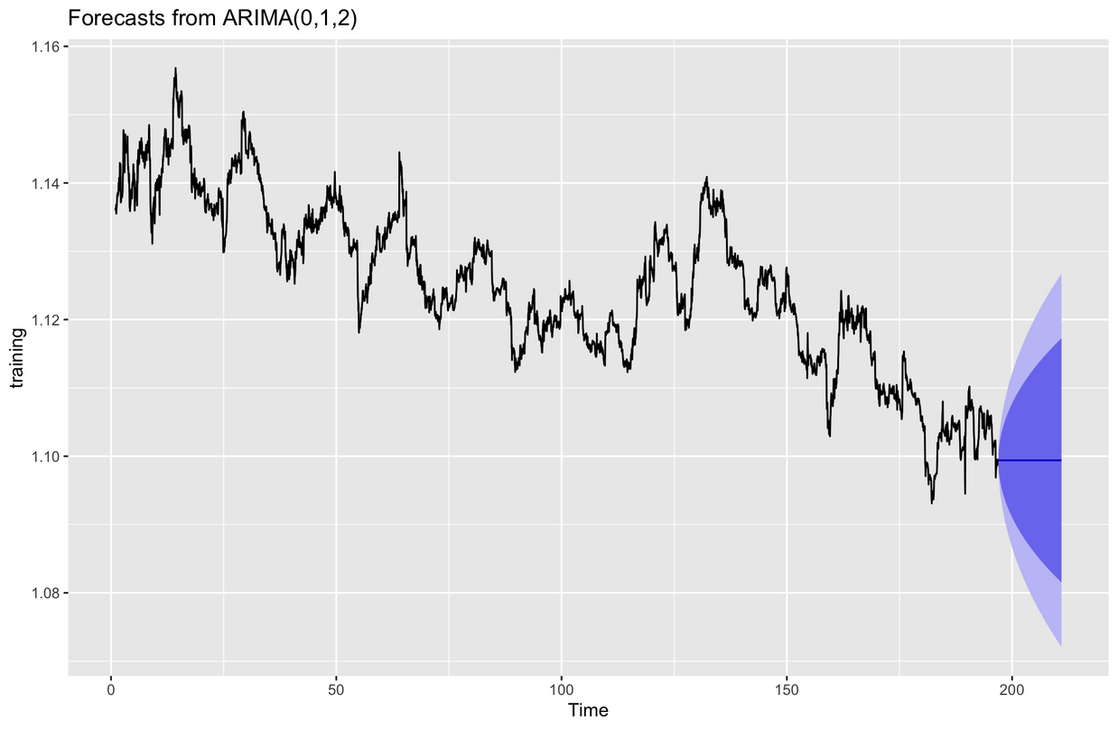
ARIMA Forecast
Based on
Visualize complicated and dense information with charts and graphs. These help people process and remember data quickly.

Slide 9

Accuracy Comparison
PLAN OPTIONS
MAPE
ME
MAPE
MAPE
MAPE
MA
AR
ARIMA
ETS

Slide 10




















Resource
Page
Use these icons and illustrations in your
Canva Presentation.
Happy designing!

